Slide 1
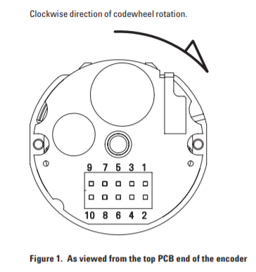
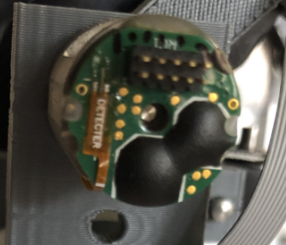
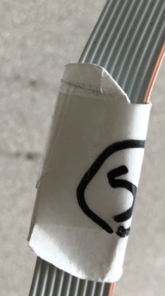
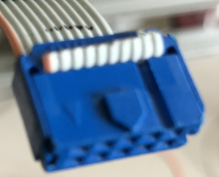
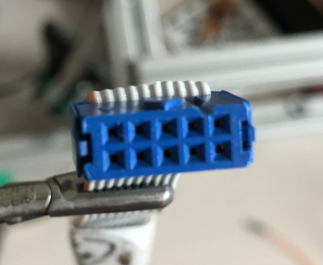
Warning: The encoder of joint 1 is actually upside down!
Joint 1
9 I+
7 Vcc
5 B+
3 GND
1 A+
Encoder side
10 I-
8 Vcc
6 B-
4 GND
2 A-
Connector side
NC
3 GND
NC
NC
NC
7&8 VCC
NC
1 A+
5 B+
9 I+
No. 5
Top side

